Slide 1
Machine Learning
Unsupervised Learning in R
June 2019

Slide 2
Content
Unsupervised Learning in R
Welcome to the course!
Identify clustering problems
Introduction to k-means clustering
k-means clustering
Results of kmeans()
Visualizing and interpreting results of kmeans()
How kmeans() works and practical matters
Handling random algorithms
Selecting number of clusters
Introduction to the Pokemon data
Practical matters: working with real data
Review of k-means clustering
Hierarchical Clustering
Introduction to hierarchical clustering
Hierarchical clustering with results
Selecting number of clusters
Interpreting dendrogram
Cutting the tree
Clustering linkage and practical matters
Linkage methods
Comparing linkage methods
Practical matters: scaling
Comparing kmeans() and hclust()
Review of hierarchical clustering
Dimensionality Reduction with PCA
Introduction to PCA
PCA using prcomp()
Results of PCA
Additional results of PCA
Visualizing and interpreting PCA results
Interpreting biplots(1)
Interpreting biplots(2)
Variance explained
Visualize variance explained
Practical issues with PCA
Practical issues: scaling
Additional uses of PCA and wrap-up
Putting It All Together with a Case Study
Introduction to the case study
Preparing the data
Exploratory data analysis
Performing PCA
Interpreting PCA results
Variance explained
Communicating PCA results
PCA review and next steps
Hierarchical clustering of case data
Results of hierarchical clustering
Selecting number of clusters
k-means clustering and comparing results
Cluster on PCA results
Wrap-up and review

Slide 3
Discussion
Many times in ML, the goals is to find patterns in data without trying to make predictions – this is referred to as unsupervised learning. More specifically, this course focuses on clustering and dimensionality reduction.
There are two primary goals of unsupervised learning:
Find homogenous subgroups within larger group
Find patterns in the features of the data (dimensionality reduction is one way to do this)
There are three primary goals of dimensionality reduction:
Find patters in the features of the data
Visualization of high dimensional data
Pre-processing before supervised learning
Challenges and benefits of unsupervised learning:
No signle goal of the analysis
Requires more creativity
Much more unlabeled data available than cleanly labels data

Slide 4

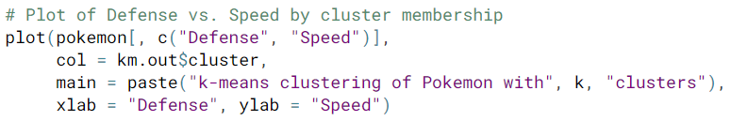
km.out <- kmeans(x, centers = 3, nstart = 20)
summary(km.out)
print(km.out$cluster)
print(km.out)
plot(x, col = km.out$cluster,
main = “k-means with 3 clusters,
xlab = “”, ylab = “”)
par(mfrow = c(2, 3))
set.set(1)
for (i in 1:6) {
km.out <- kmeans(x, centers = 3, start = 1, iter.max = 50)
plot(x, col = km.out$cluster,
main = km.out$tot.withinss,
xlab = “”, ylab = “”)
}
wss <- 0
for (i in 1:15) {
km.out <- kmeans(x, centers = i, nstart = 20)
wss[i] <- km.out$tot.withinss
}
plot(1:15, wss, type = “b”,
xlab = “Number of Clusters”,
ylab = “Within groups sum of squares”)
Model Selection
k-means has a random component
best outcome is based on total within cluster sum of squares
If you don’t know the number of clusters in advance and need to determine it, you’ll have to run the algorithm multiple times with differing number of clusters. From these iterations, you can observe how model quality changes with the number of clusters. A scree plot is used for this purpose.
sum of the squared (Euclidean) distance for each observation with each cluster
best outcome is the minimum of this metric
available components
cluster, centers, totss, withinss, tot.withinss
betweenss, size, iter, ifault
Data Challenges
Selecting the variables to cluster upon
Scaling the data
Determining the number of clusters
Visualize the results for interpretation
Unsupervised Learning in R

Slide 5
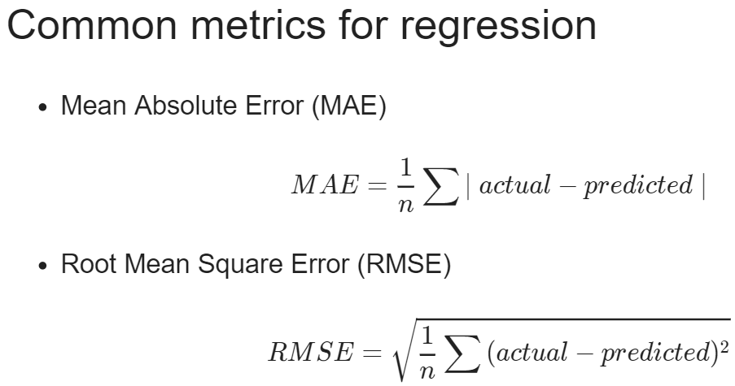
grade is a data frame
libraries → Metrics
set.seed(1)
assignment <- sample(1:3, size = nrow(grade), prob = c(0.7, 0.15, 0.15), replace = TRUE)
grade_train <- grade[assignment == 1, ]
grade_valid <- grade[assignment == 2, ]
grade_test <- grade[assignment == 3, ]
grade_model <- rpart(formula = final_grade ~ .,
data = grade_train,
method = “anova”)
rpart.plot(x = grade_model, yesno = 2, type = 0, extra = 0)
grade_pred <- predict(object = grade_model, newdata = grade_test)
library(Metrics)
rmse(actual = grade_test$final_grade, predicted = grade_pred)
plotcp(grade_model) print(grade_model$cptable)
opt_index <- which.min(grade_model$cptable[ , “xerror”])
cp_opt <- grade_model$cptable[opt_index, “CP”]
grade_model_opt <- prune(tree = grade_model, cp = cp_opt)
rpart.plot(x = grade_model_opt, yesno = 2, type = 0, extra = 0)
you can see this model using print(grade_model)
Regression Trees

Slide 6
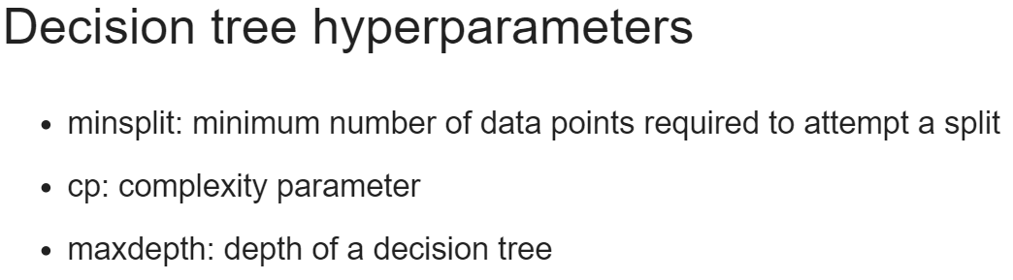
minsplit <- seq(1, 4, 1)
maxdepth <- seq(1, 6, 1)
hyper_grid <- expand.grid(minsplit = minsplit, maxdepth = maxdepth)
num_models <- nrow(hyper_grid)
grade_models <- list()
for (i in 1:num_models) {
minsplit <- hyper_grid$minsplit[i]
maxdepth <- hyper_grid$maxdepth[i]
grade_models[[i]] <- rpart(formula = final_grade ~ .,
data = grade_train,
method = “anova”,
minsplit = minsplit,
maxdepth = maxdepth)
}
num_models <- length(grade_models)
rmse_values <- c()
for (i in 1:num_models) {
model <- grade_models[[i]]
pred <- predict(object = model, newdata = grade_valid)
rmse_values[i] <- rmse(actual = grade_valid$final_grade, predicted = pred)
}
best_model <- grade_mdoels[[which.min(rmse_values)]] best_model$control
pred <- predict(object = best_model, newdata = grade_test)
rmse(actual = grade_test$final_grade, predicted = pred)
Just like a test set, a validation set is used to evaluate the performance of a model. The difference is that a validation set is specifically used to compare the performance of a group o fmodels with the goal of choosing a “best model” from the group. All models in a group are evaluated on the same validation set and the model with the best performance is considered to be the winner.
Once you have the best model, a final estimate of performance is computed on the test set.
Regression Trees

Slide 7
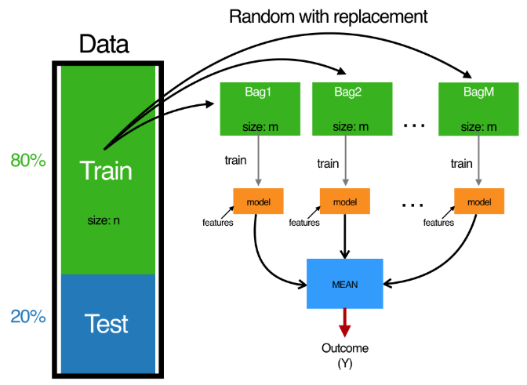
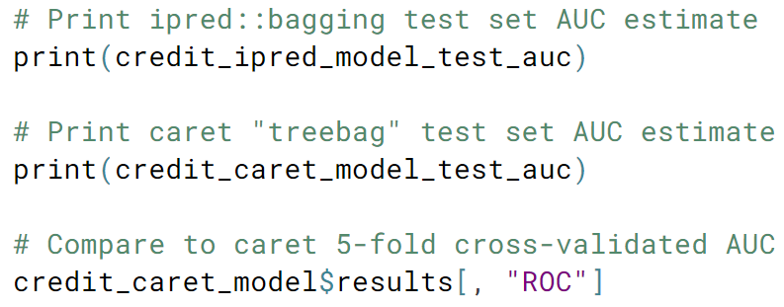
creditsub is a data frame
libraries → ipred, Metrics, caret
Bagged trees combines many trees with the goal of reducing variance.
Bagging ← Bootstrap Aggregating
model object names(credit_model)
set.seed(123)
credit_model <- bagging(formula = default ~ .,
data = credit_train, coob = TRUE)
credit_pred <- predict(object = credit_model,
newdata = credit_test, type = “class”)
auc(actual = ifelse(credit_test$default == “yes”, 1, 0),
predict = pred[ , “yes”])
ctrl <- trainControl(method = “cv”,
number = 5,
clasasProbs = TRUE,
summaryFunction = twoClassSummary)
set.seed(1)
credit_caret_model <- train(default ~ .,
data = credit_train,
method = “treebag”,
metric = “ROC”,
trControl = ctrl)
credit_caret_model$results[ , “ROC”]
credit_pred <- predict(object = credit_caret_model,
newdata = credit_test, type = “prob”)
auc(actual = ifelse(credit_test$default == “yes”, 1, 0),
predict = pred[ , “yes”])
“prob” changes this to a predicted value as opposed to a class label
In binary classification, we can predict numeric values instead of class labels. In fact, class labels are created only after you use the model to predict a raw, numeric, predicted value for a test point.
The predicted label is generated by applying a threshold to the predicted value, such that all test points with predicted value greater than the threshold get a label of “1” and points below get a label of “0”.
model object names(credit_caret_model)
Bagged Trees

Slide 8
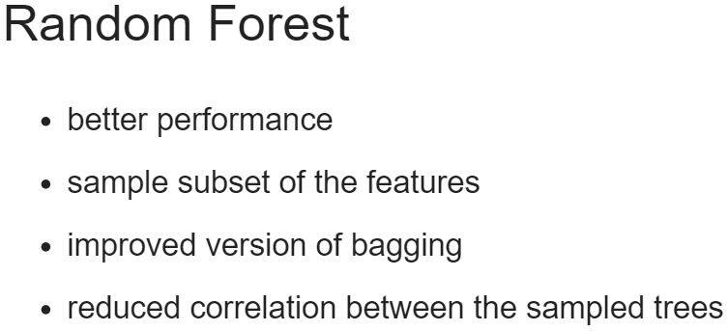
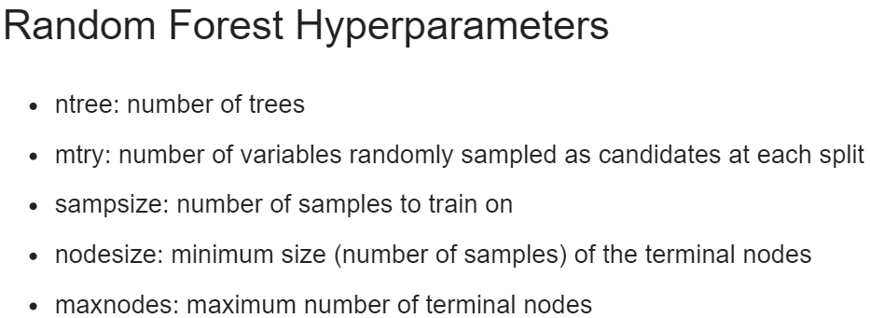
creditsub is a data frame
libraries → randomForest, caret
set.seed(1)
library(randomForest)
credit_model <- randomForest(formula = default ~ ., data = credit_train)
err <- credit_model$err.rate
oob_err <- err[500, “OOB”]
plot(credit_model)
legend(x = “right”, legend = colnames(err), fill = 1:ncol(err))
credit_pred <- predict(object = credit_model,
newdata = credit_test, type = “class”)
cm <- confusionMatrix(data = class_prediction,
reference = credit_test$default)
paste0(“Test Accuracy: ”, cm$overall[1])
paste0(“OOB Accuracy: ”, 1 – obb_err)
credit_pred <- predict(object = credit_caret_model,
newdata = credit_test, type = “prob”)
auc(actual = ifelse(credit_test$default == “yes”, 1, 0),
predict = pred[ , “yes”])
set.seed(1)
res <- tuneRF(x = subset(credit_train, select = -default),
y = credit_train$default, ntreeTry = 500)
mtry_opt <- res[ , “mtry”][which.min(res[ , “OOBError”])]
model object names(credit_model)
OOB (out-of-bag error)
mtry <- seq(4, ncol(credit_train) * 0.8, 2)
nodesize <- seq(3, 8, 2)
sampsize <- nrow(credit_train) * c(0.7, 0.8)
hp_grid <- expand.grid(mtry = mtry,
nodesize = nodesize,
sampsize = sampsize)
for (i in 1:nrow(hp_grid) {
model <- randomForest(formula = default ~.,
data = credit_train,
mtry = hp_grid$mtry[i],
nodesize = hp_grid$nodesize[i],
sampsize = hp_grid$sampsize[i])
obb_err[i] <- model$err.rate[nrow(model$err.rate), “OOB”]
}
opt_i <- which.min(obb_err)
print(hp_grid[opt_i, ])
Note: if you want to evaluate the model based on AUC instead of error (accuracy), then this is not the best way to tune a model, as the selection only considers OOB error.
Random Forests

Slide 9
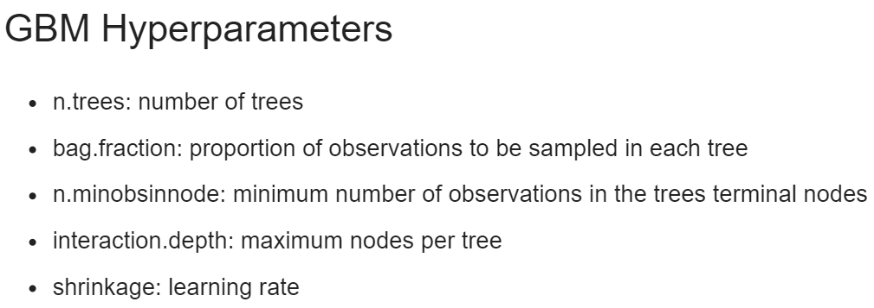
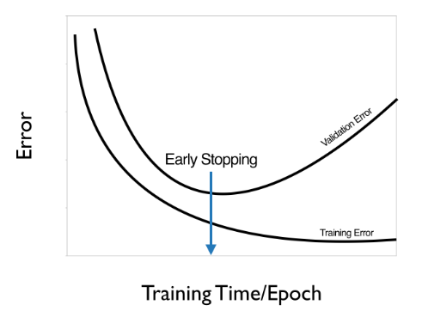
creditsub is a data frame
libraries → gbm, ROCR
credit_train$default <- ifelse(credit_train$default == “yes”, 1, 0)
set.seed(1)
library(gbm)
credit_model <- gbm(formula = default ~ .,
distribution = “Bernoulli”,
data = credit_train,
n.trees = 10000)
summary(credit_model)
credit_test$default <- ifelse(credit_test$default == “yes”, 1, 0)
credit_pred <- predict(object = credit_model,
newdata = credit_test,
n.trees = 10000)
credit_pred <- predict(object = credit_model,
newdata = credit_test,
n.trees = 10000,
type = “response”)
auc(actual = credit_test$default, predicted = credit_pred)
model object names(credit_model)
displays a variable importance table and plot
ntree_opt_oob <- gbm.perf(object = credit_model,
method = “OOB”,
oobag.curve = TRUE)
set.seed(1)
credit_model_cv <- gbm(formula = default ~ .,
distribution = “Bernoulli”,
data = credit_train,
n.trees = 10000,
cv.folds = 2)
ntree_opt_cv <- gbm.perf(object = credit_model,
method = “cv”)
pr1 <- predict(object = credit_model,
newdata = credit_test,
n.trees = ntree_opt_oob)
pr2 <- predict(object = credit_model,
newdata = credit_test,
n.trees = ntree_opt_cv)
auc1 <- auc(actual = credit_test$default, predicted = pr1)
auc2 <- auc(actual = credit_test$default, predicted = pr2)
preds_list <- list(dt_pred, bag_preds, rf_preds, gbm_preds)
m <- length(preds_list)
actuals_list <- rep(list(credit_test$default), m)
preds <- prediction(preds_list, actuals_list)
rocs <- performance(pred, “tpr”, “fpr”)
plot(rocs, col = as.list(1:m), main = “Test Set ROC Curves”)
legend(x = “bottomright”, legend = c(“Decision Tree”, “Bagged Trees”, “Random Forest”, “GBM”), fill = 1:m)
Random Forests

